Slide 1
Traffic Light System
By Adam Sulak and Niklas Kohlhage

Slide 2
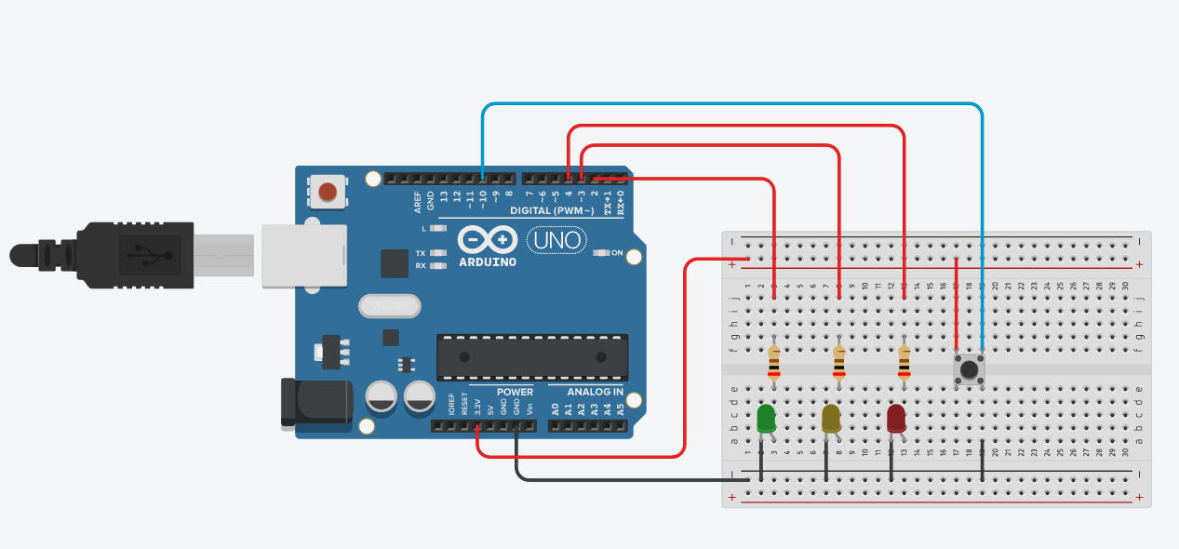
The Circuit

Slide 3
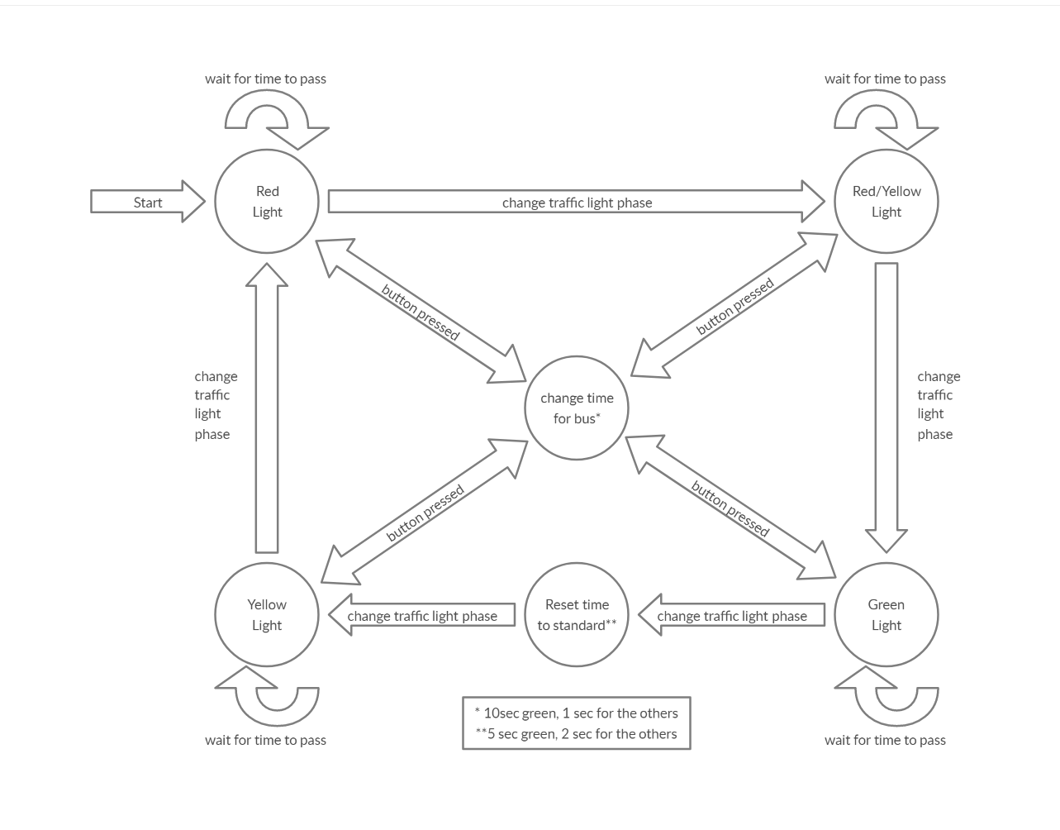
State Machine Diagram

Slide 4
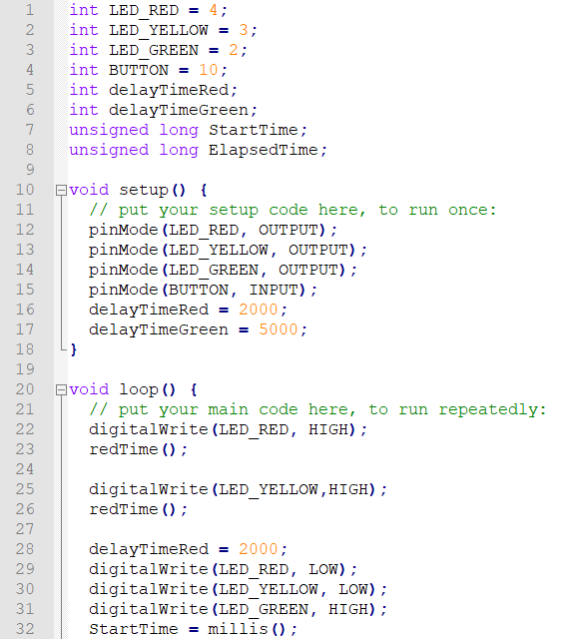
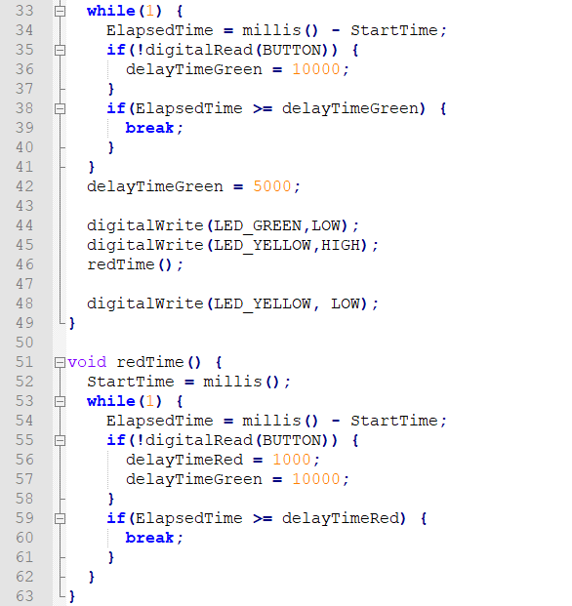
The code

